Slide 1

Professorial kvetches

Slide 2
Software Architectures

Slide 3
Software Architecture
What is an architecture?
External view
What does that mean for software?
Two definitions
User interface (product architecture)
Highest level design (software architecture)

Slide 4
Software Architecture Goals
Extensibility: adding new features
Tradeoff of generality and time
How might it be extended?
Changeability: requirements changes
Simplicity: ease of understanding and implementing
Efficiency: speed and size

Slide 5
Key Characteristics
Cohesion
degree to which communication takes place within the module
Coupling
degree to which communication takes place between modules
Min-max problem:
minimize coupling; maximize cohesion

Slide 6
Categorizing Software Architectures (Shaw and Garlan)
Model-View-Controller
Data flows
Viewed as data flowing among processes
Independent components
Components operating in parallel and communicating occasionally
Virtual machines
Treats an application as a program written in a special-purpose language
Layered architectures
Packages of function with a strong hierarchical uses relationship
Repository
Application built around data

Slide 7
Why Categorize?
Recognize patterns
Reuse designs
Learn from other similar applications
Reuse classes
Simplify communication

Slide 8
Examples of Use (real quotes)
… is based on the client-server model and uses remote procedure calls ...
Abstraction layering and system decomposition provide the appearance of system uniformity to clients …
The architecture encourages a client server model …
We have chosen a distributed, object-oriented approach
The easiest way … is to pipeline the execution …

Slide 9
Well-known Architectures
Model-View Controller
Data flows
Independent components
Virtual machines
Layered architectures
Repository

Slide 10
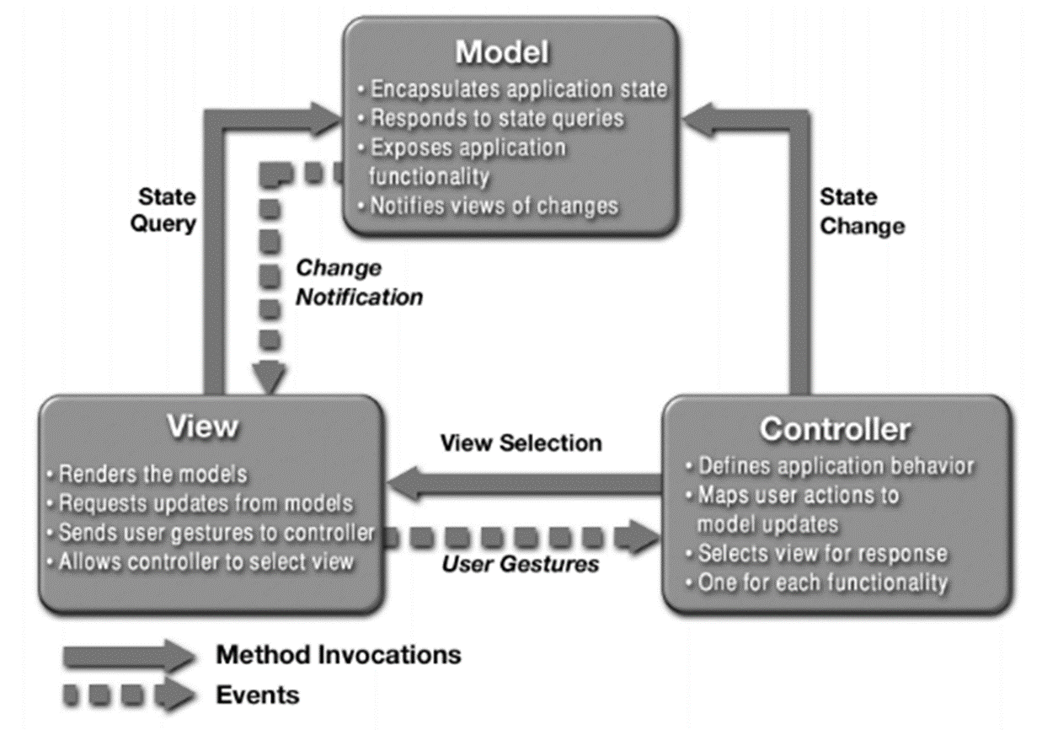
Model-View-Controller
Originally designed for SmallTalk
Early OO language (1970’s)
Steve Burbeck, 1987
early paper

Slide 11
Data Flow Design
Data flowing among processes
Two categories:
Pipes and filters
Filters: processes
Pipes: input streams
Batch sequential
Pipe and filter where input streams are batches of data
filter
filter
filter
pipe
filter
filter
filter
filter
filter
filter
filter
filter
filter
filter
filter
filter
pipe
filter
filter
filter
pipe
Collect
mortgage funds
Mortgage
pool
Account
balances
Collect
unsecured funds
Unsecured
pool

Slide 12
Independent Components
Components
operating in parallel
communicating occasionally
Different types
Client-server
Parallel communicating processes
Event systems
Service Oriented Architecture
Notes:
Client-server
Browser-web server most familiar example
Separate systems with narrow interface
Sometimes expanded to three tiers (why?)
Façade pattern (single unified interface)
Parallel communicating processes
Several processes executing at the same time
Typically modeled with sequence diagrams
Observer pattern (one-to-many dependencies)
Event systems
Set of components waiting for input
Example: word processor waiting for user input
State transition diagrams
State pattern (alter behavior depending on state)
Service Oriented Architecture

Slide 13
Client-Server and Facade
Façade
«exposed»
Browser-web server most familiar example:
Separate systems with narrow interface
1
Client
2
Key concept: limit exposed interface
«not exposed»
«not exposed»
P
«not exposed»
«not exposed»
«not exposed»
Adapted from Software Engineering: An Object-Oriented Perspective by Eric J. Braude (Wiley 2001), with permission.

Slide 14
Parallel Communicating Processes
processes
Session:
session m
Session:
session k
Account:
customer n
checking
Customer:
customer n
actions
Customer:
customer n+1
create
Account:
customer
n+1 saving
retrieve
create
retrieve
deposit
withdraw
Duration of process
3 types of processes, 2 instances of each
sequence diagram
Adapted from Software Engineering: An Object-Oriented Perspective by Eric J. Braude (Wiley 2001), with permission.

Slide 15
Observer Design Pattern
Client of this
system
Single source of data with a number of clients that need to be updated
1
Request others be notified
1..n
Source
notify()
Observer
update()
2
Notify all observers
ConcreteObserver
observerState
update()
ConcreteSubject
state
3
Determines if change needed
Gamma et al

Slide 16
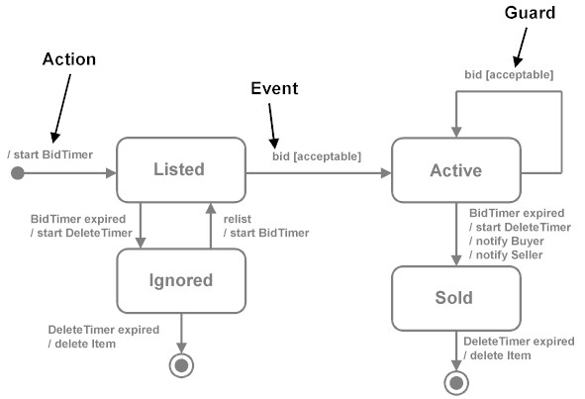
Event Systems and State Transition Diagrams
Set of components waiting for input
Set of components waiting for input

Slide 17
Services Oriented Architecture
Collection of services
Direct communication
Coordinating service
Different technologies
Early ones: DCOM CORBA (brokers)
Web Services
Lots of different models and tools: REST (REpresentational State Transfer using HTTP just one)

Slide 18
Virtual machines
Treats an application as a program written in a special language
Payoff is that the interpreter code is the basis for multiple applications
Two types
Interpreters (JVM)
Rule-based systems (AI)

Slide 19
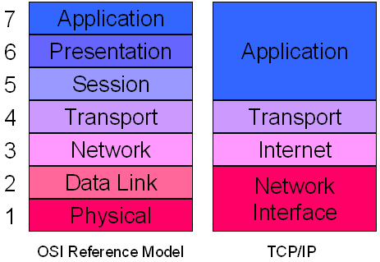
Layered Architecture: Network
OSI
TCP/IP

Slide 20
Repository
A system built around data
Two types
Databases
Hypertext systems

Slide 21
A Typical Repository System
GUI
Analysis
process
1
Analysis
process
n
Control
…...
…...
DBMS
Database
Adapted from Software Engineering: An Object-Oriented Perspective by Eric J. Braude (Wiley 2001), with permission.

Slide 22
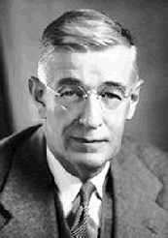
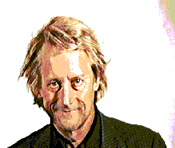
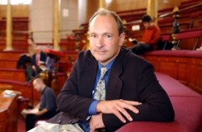
Hypertext: Basis of the Web
Motivated by Vannevar Bush in 1945
“As We May Think” (Atlantic Monthly)
Theoretical machine, "memex," to enhance human memory by allowing the user to store and retrieve documents linked by associations
Invented by Ted Nelson in the 1960s
Popularized with HTML (Tim Berners-Lee)

Slide 23
Ted Nelson
"If computers are the wave of the future, displays are the surfboards."
Xanadu: 1974
"give you a screen in your home from which you can see into the world's hypertext libraries... offer high-performance computer graphics and text services at a price anyone can afford... allow you to send and receive written messages... [and] make you a part of a new electronic literature and art, where you can get all your questions answered...“
Computer Lib/Dream Machines
For more details, see pdf

Slide 24
Summary
Model-View-Controller Web application
Data flow systems Pipes and filters
Batch sequential
Independent components Client-server
Parallel communicating processes
Event systems
Service Oriented Architecture
Virtual machines Interpreters
Rule-based systems
Layered architectures
Repositories Databases
Hypertext systems

Slide 25
Examples from Prior Years

Slide 26
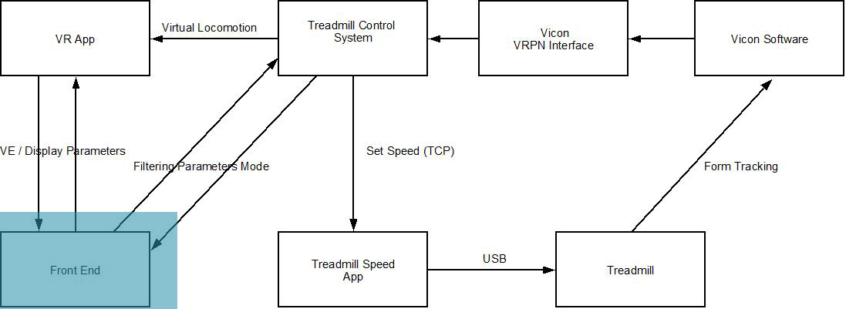
Virtual Reality for Stroke Patients

Slide 27
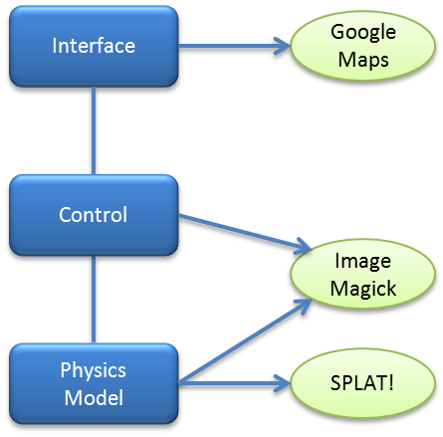
Wireless Deployment

Slide 28
What is Your Architecture?
10 minute discussion and 1 minute presentation

Slide 29
Frameworks

Slide 30
What is a Framework?
Infrastructure to avoid programming pain
Allows user to override
Really no different than “packages” or “libraries” or “platform”

Slide 31
Thursday Discussion
Each team is to do some homework on a framework to allow concrete discussion
No written assignment or deliverable
CHOOSE
Be prepared with
Language, platform, intended use, benefits, drawbacks

